Slide 1
Global Spec Interface
Engineering Services, Infosys

Slide 2












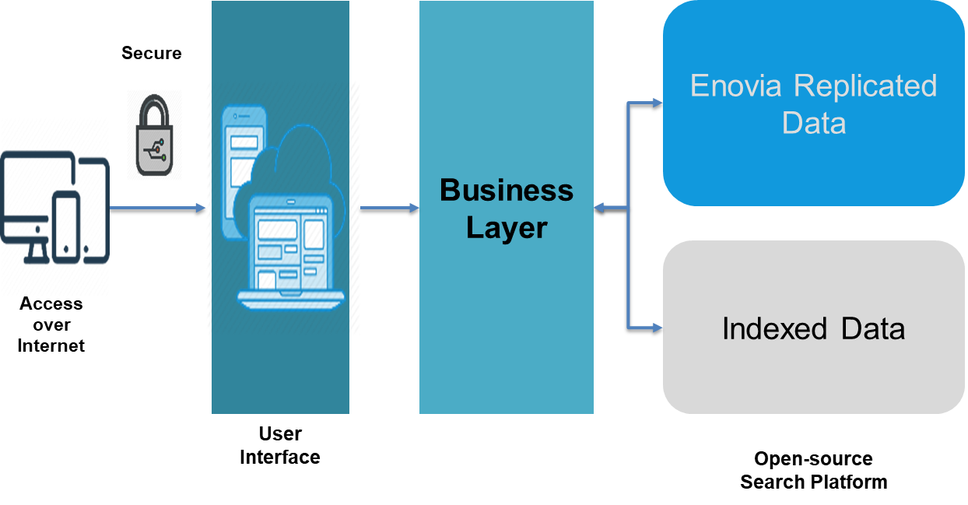

















Why is Light Viewer Global Spec Interface needed?
Unpredicted read only/casual users from internal, external and suppliers' side add to additional unplanned license cost for COTS products implementation
Complicated interface of PLM needing users to navigate through multiple screens to find the details of their custom preference.
Performance issues as multiple write transactions and batch jobs running at same time. Sometimes Database lock performance issues are added causing problem to simple users.
Business critical applications need read only copy during build and outage which helps to continue business critical applications.
Traditional PLM application lack responsive web designs which make them difficult to use over the mobile devices.
Challenges
Unpredicted Guest Users adding cost
Complex UI Navigation
Not Mobile Device Friendly
Performance Issues
Emergency Archive
Quick Access
Simplified UI
Performance Improvement
Mobile Device Ready
SSO/ MFA
Happy Vendor
Controlled Governance
Reduced TCO
Benefits
Quick access to different kinds of specification
Better User Experience, Simplified UI, Less Clicks
Performance improvement over Enovia screen load
Mobile device ready, Provide high availability for factory operations
Access via LDAP / MFA over internet (No VPN)
Improve vendor collaboration, vendor satisfaction,accuracy of information
Control distribution of highly secured Intellectual Property
Reduce total cost of ownership of existing solutions

Slide 3
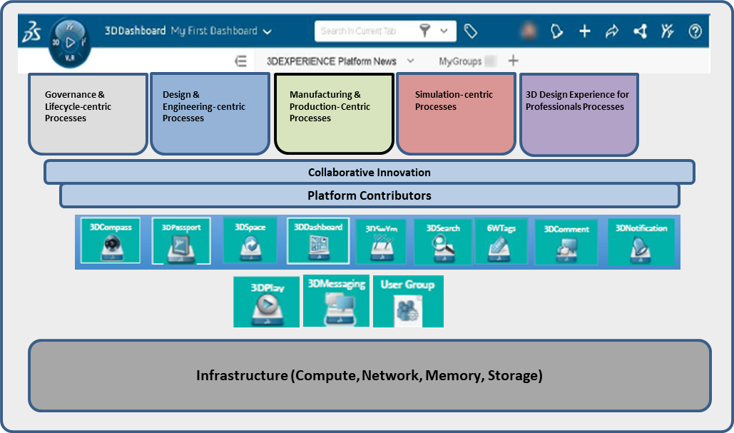



About PLM Light Viewer
PLM Light viewer would be a custom application that would help end users in searching PLM data in a faster way. It would be useful for customers to on board suppliers where they have to only view/download specifications from PLM system. Also, it could be hosted on internet, so suppliers can be onboarded quickly. In addition to it, it would help customer to save on license cost.
Secure
3DEXPERIENCE
Access over Internet
Business Layer
Enovia Replicated Data
Secure
PLM Light VIewer
Indexed Data
Access over Internet
User Interface
Open-source Search Platform

Slide 4
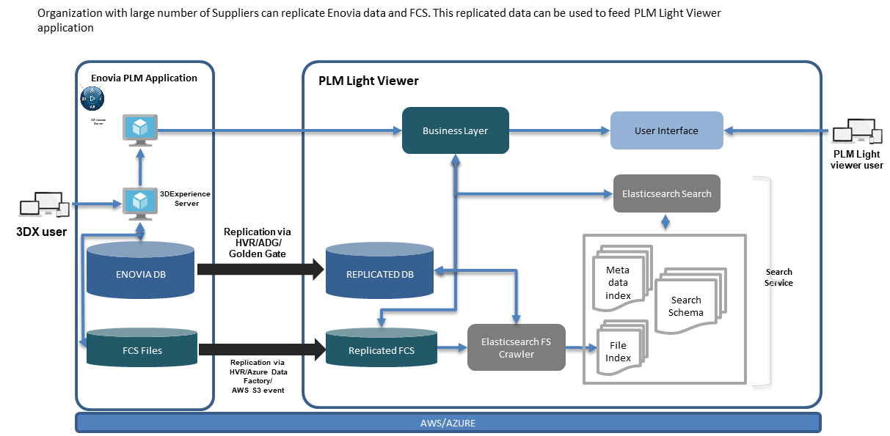
Case Study - Read Only , Cloud based Specification Management System for supplier and manufacturer for large CPG customer
Client Profile
Business Challenges
An American multinational consumer goods corporation
Current Engagement: Provide end to end implementation of cloud based light weight user friendly Spec Management System.
Heavily customized complex application landscape involving Dassault ENOVIA and Exalead based Specification Management System.
Very high cost of ENOVIA based license even for read only usage of the specification Management system.
Performance issues in accessing basic use cases like searching and viewing a specification and file attachments
Current system is not very user friendly for mobile and handheld devices.
Current Specification Management system has bottlenecks in certain geographical regions which could not be scaled very easily during season specific peak usage.
Security model for current system is very complex and having product specific design which makes it difficult to move into any other system
Solution & Approach
Implementation of MQL Micro-Services layer for data access
Consumption of single license
Integration layer for user request gateway
React UI for lighter user experience
Responsive web design
Multi region Azure based solution
Key Differentiator
Business Benefits / Value Delivered
Consumption of just single license for MQL microservices causing saving of all read only licenses related to specification management system.
Every spec request is loaded within 3 seconds.
Cost saving of Exalead license by implementing open-source custom search based on Elastic Search.
Handheld device friendly user interface for mobile users.
Build time for current ENOVIA based production is 18 hours which needed additional read-only environment to be brought up every weekend during build time. This activity will be eliminated saving time.
Micro Services based architecture that can be extended for any COTS package or custom application.
Single page application reducing the number of clicks in native application for better user experience.

Slide 5
THANK YOU

